Slide 1

UAE Digital City
Parallel World
What We Have
An MMO Monopoly-style game featuring Abu Dhabi and Dubai, with scope to add major cities worldwide.
A gaming ecosystem that can expand into consumer spending and real estate. Plus, 10M operation fund.
What We Can Do
Make Abu Dhabi a hub of global games as well as business wealth distributor for gamers, similar to YouTube in the content industry for influencers.
US$10M
US$1B
What We Need
Government permission for this business model;
License allowing Parallel World to sell fractional property ownership
Operation Funds
Future Spending Locked in Phase One

Slide 2
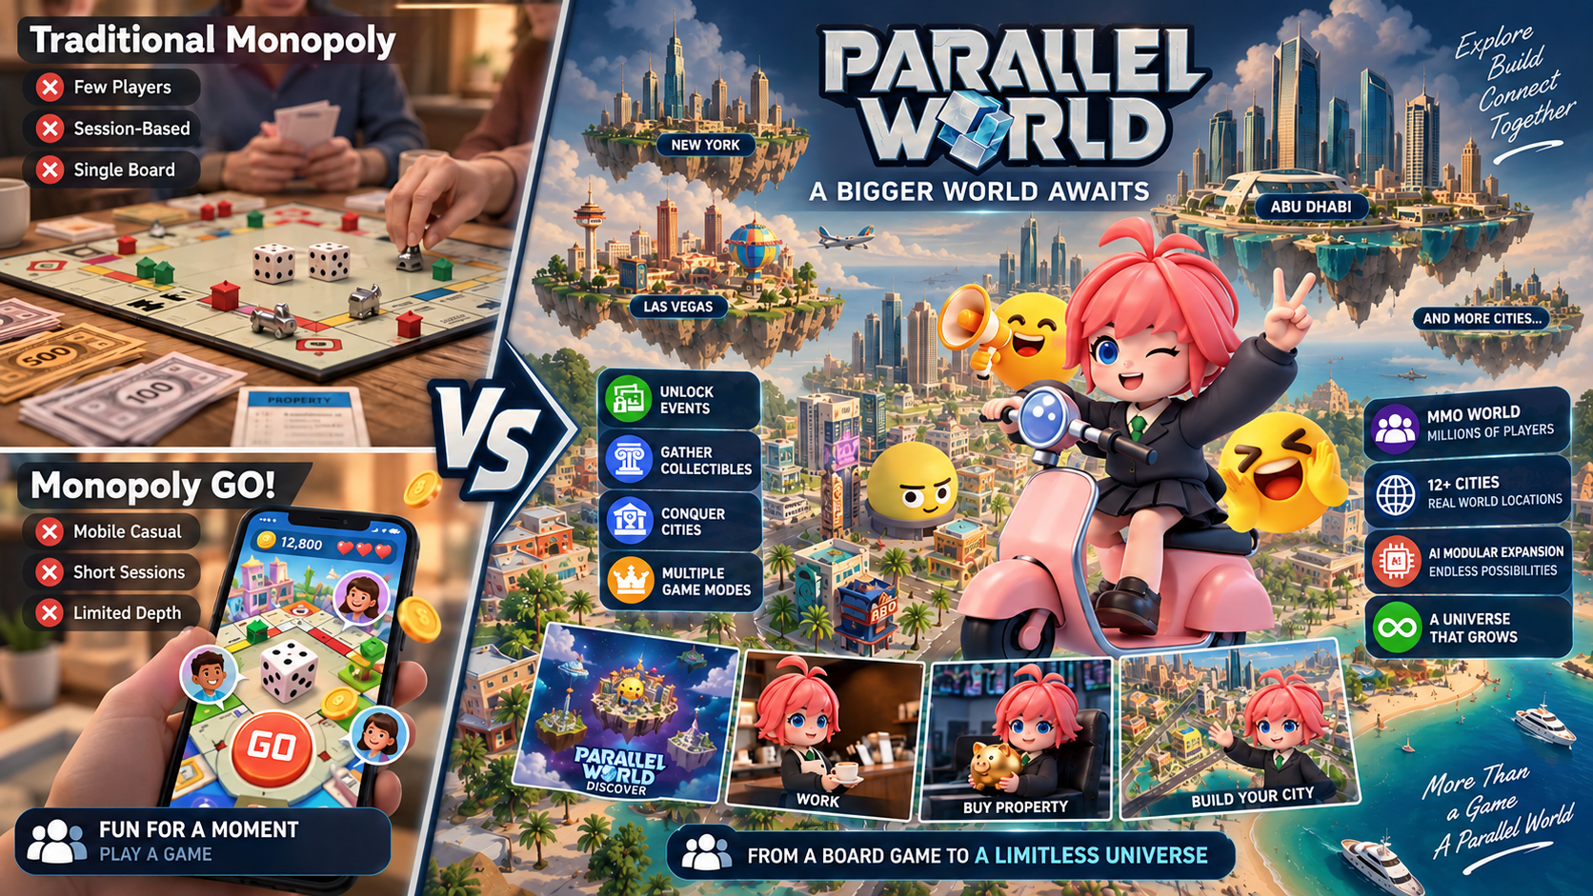
Notes:
MONOPOLY has reached over 1 billion players worldwide, while MONOPOLY GO! surpassed 300 million downloads in just over three years. MONOPOLY GO! launched in April 2023 and surpassed $6 billion in cumulative in-app purchase revenue by 2025, proving the enormous commercial potential of bringing the MONOPOLY experience into the digital era.
Unlike traditional MONOPOLY, our game is a true MMO, and able to support hundreds of cities and millions of players in one persistent world.

Slide 3
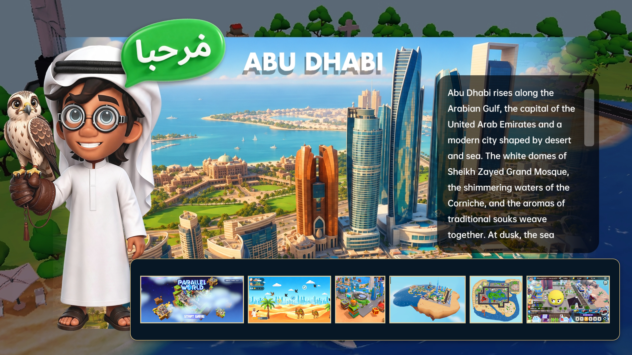
Notes:
After 2 years development by a team of 30 staff members, we own 100% of the IP, enabling full customization. We currently have 12 cities, including Dubai, Abu Dahbi, Tokyo, Paris, Singapore, Las Vegas, New York, etc. We are building AI engine for city creation and rapid global expansion.

Slide 4

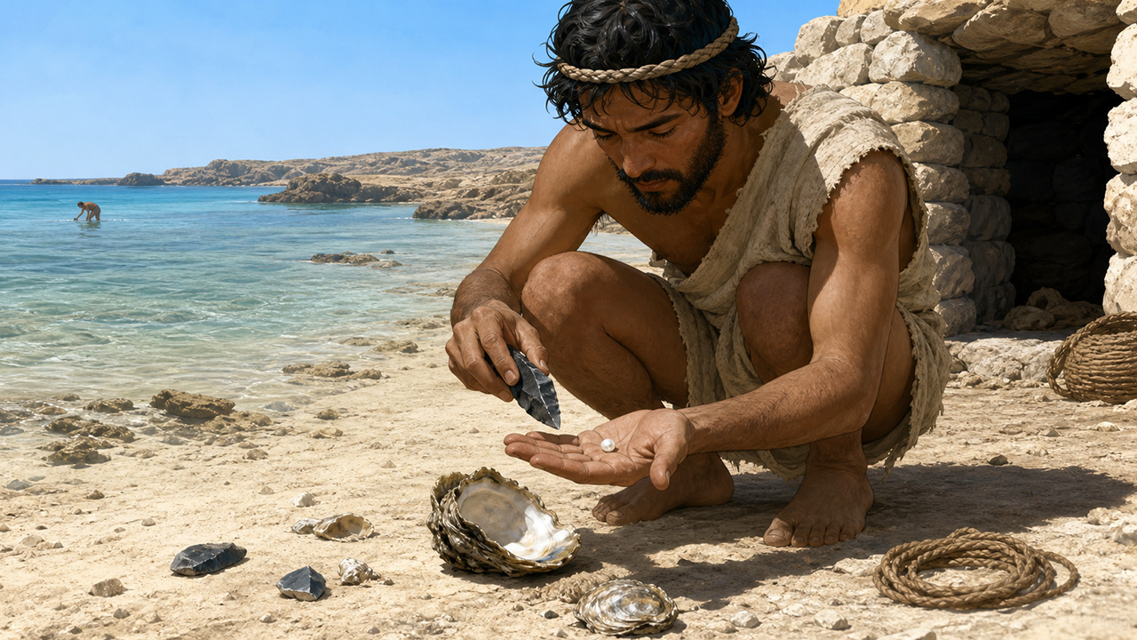
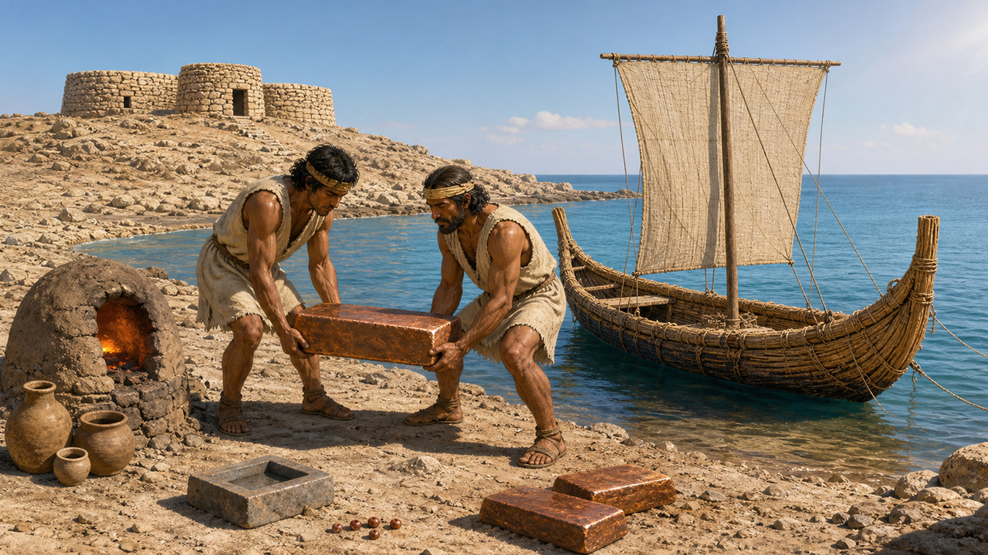
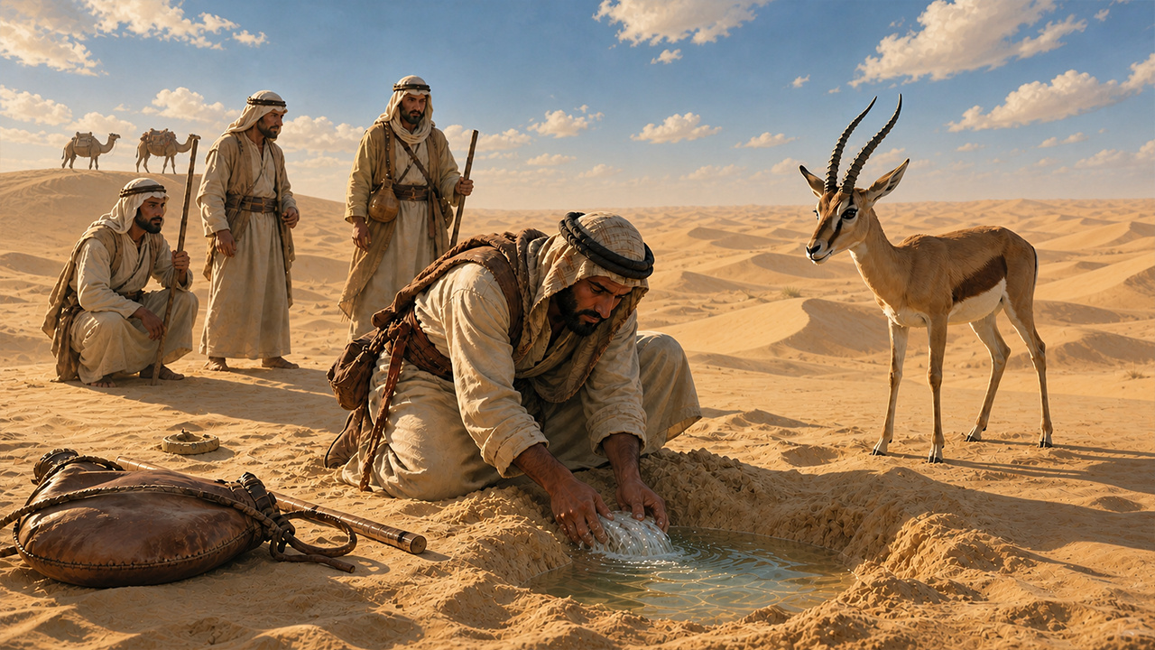

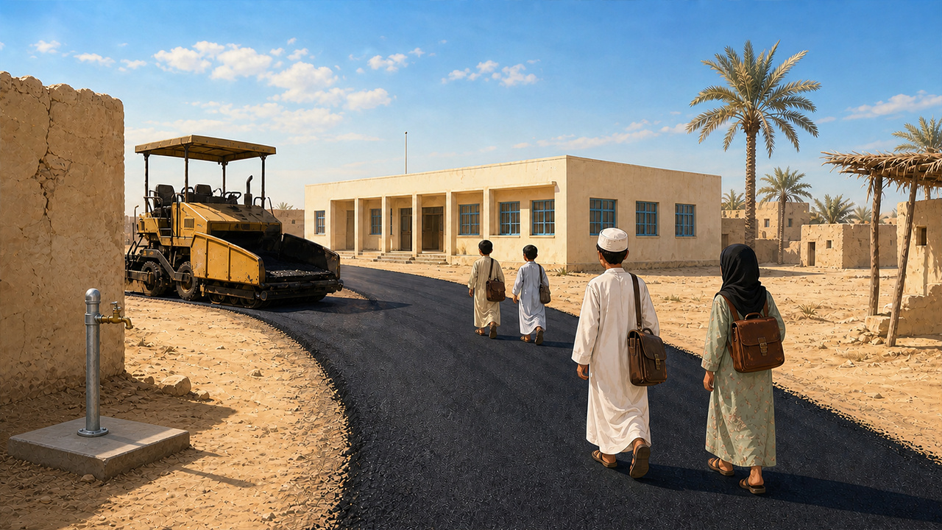
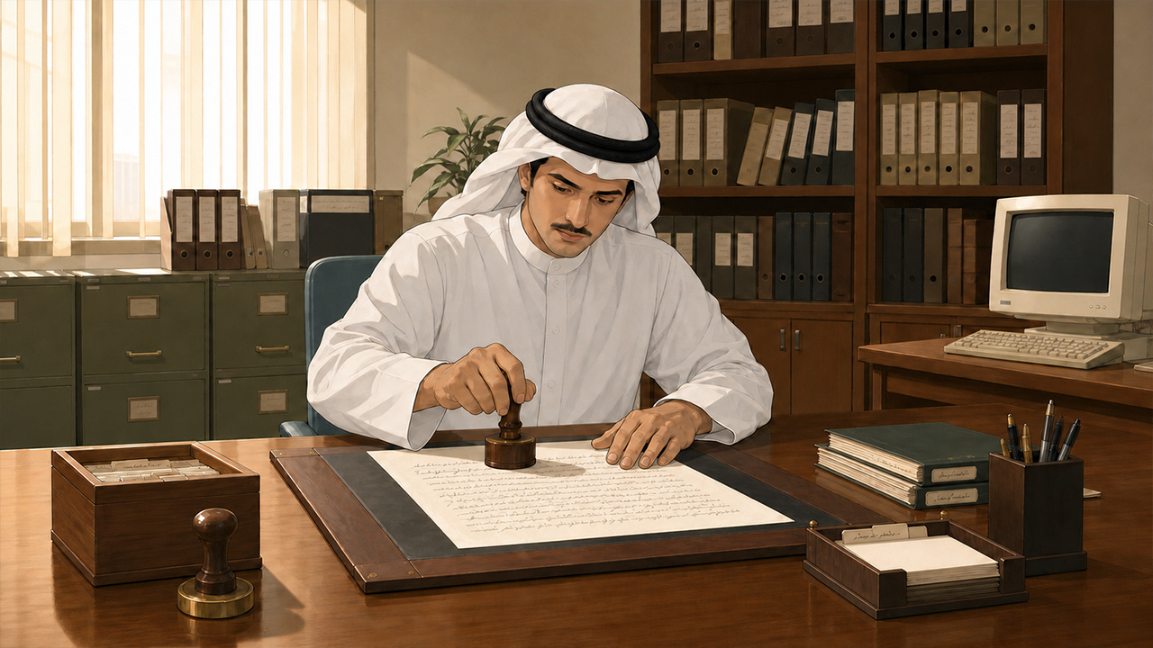

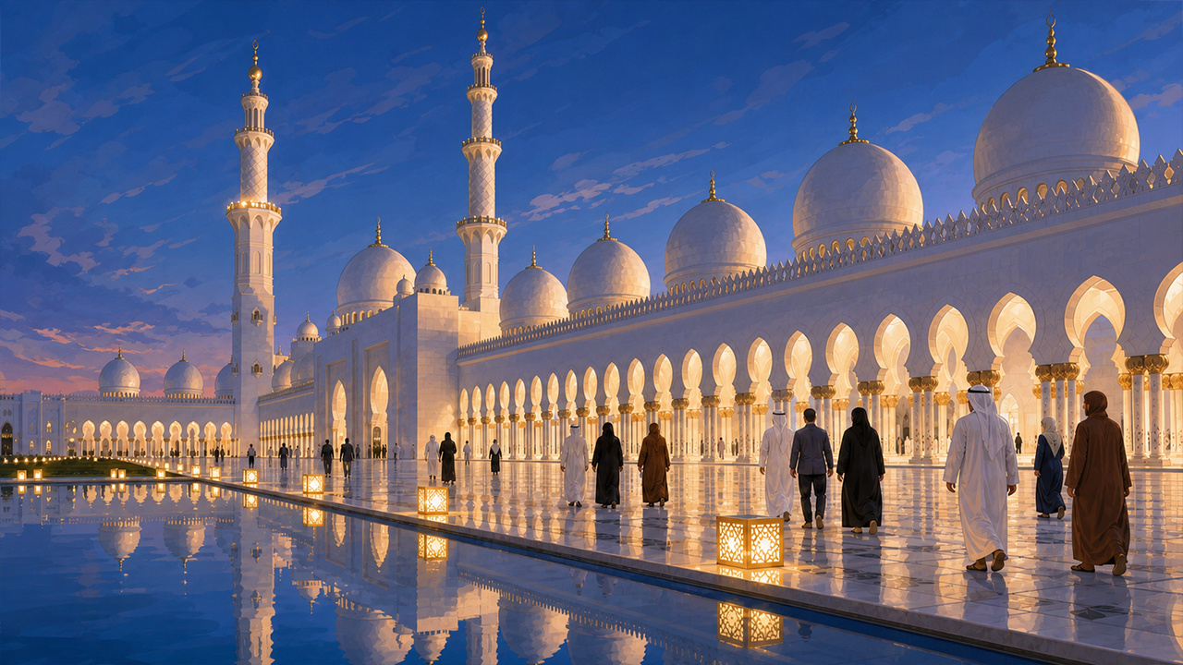
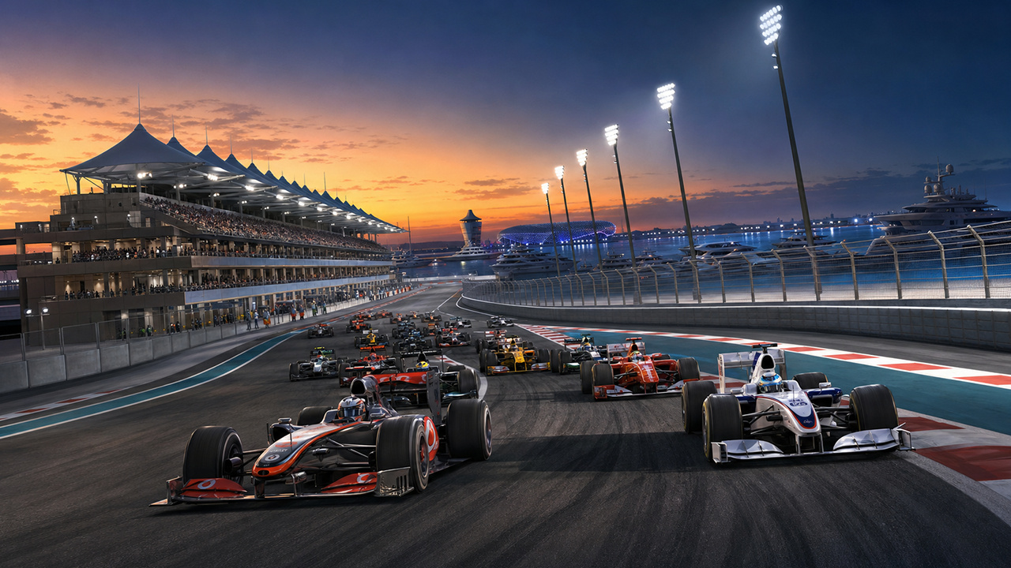
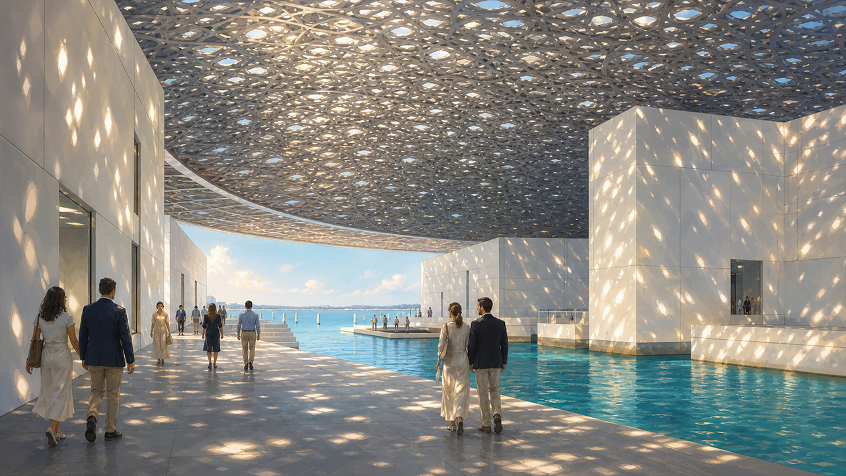
Abu Dhabi | Historical Events
10 IMAGES
Notes:
Through the game, players can explore the UAE’s history of development and celebrate its achievements.

Slide 5
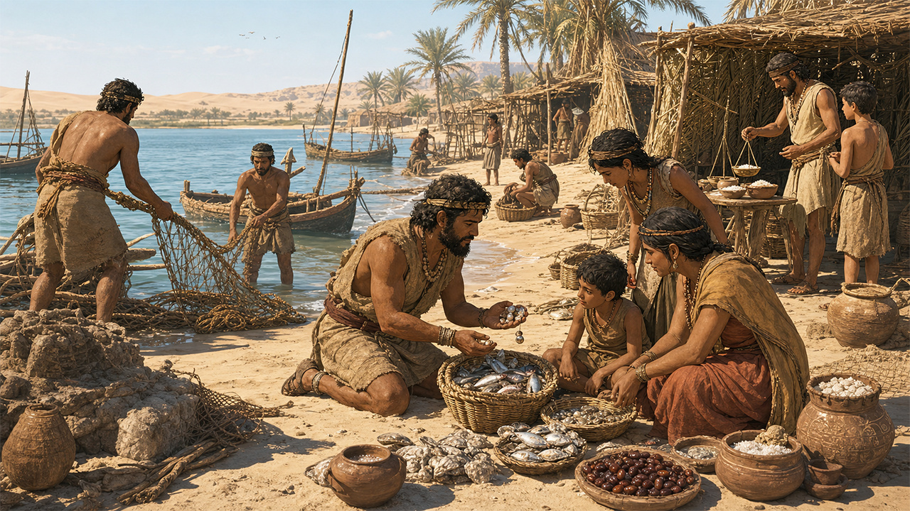
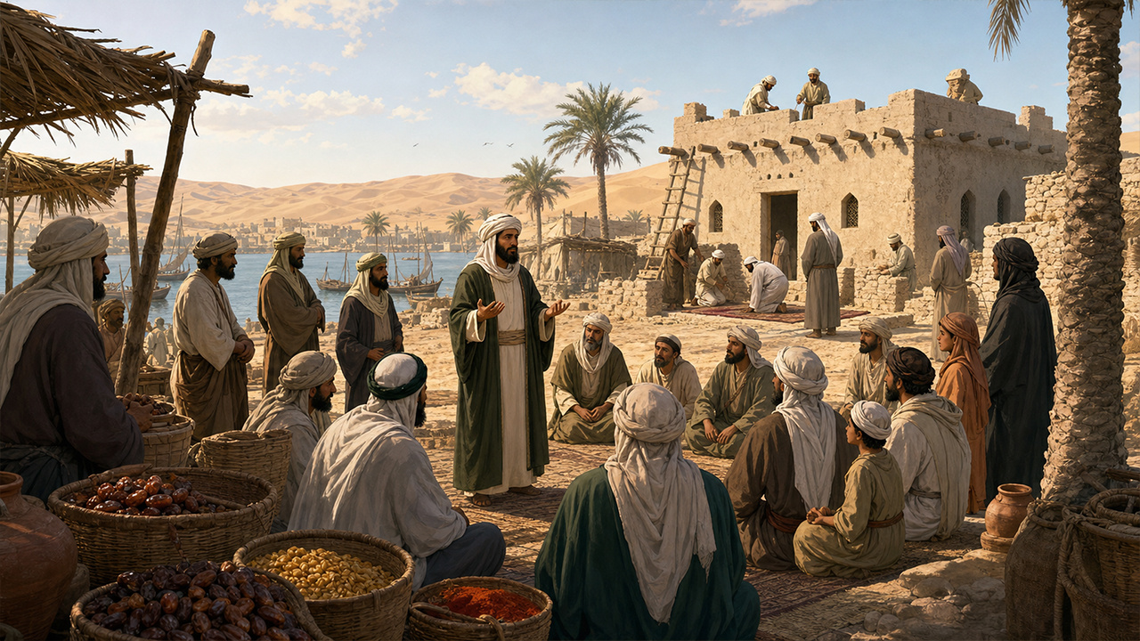
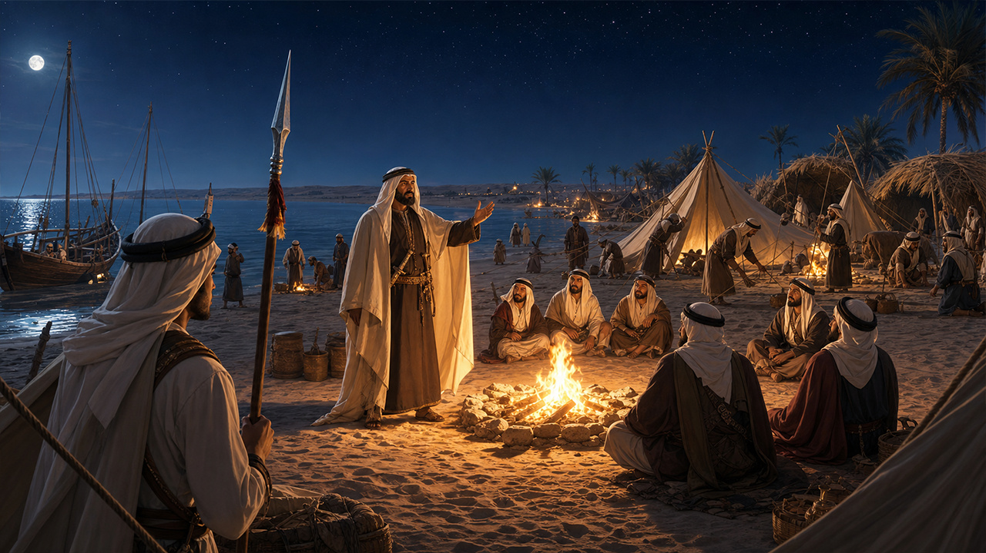
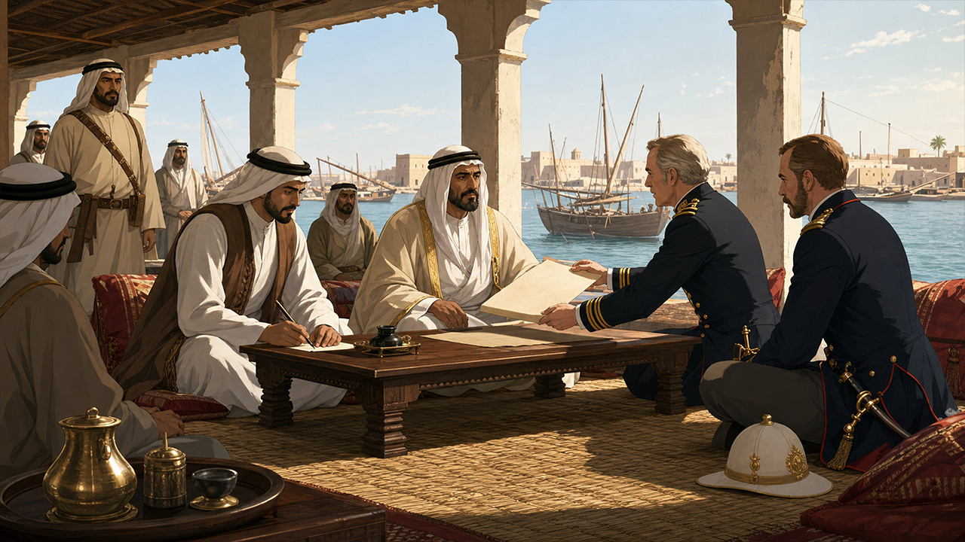
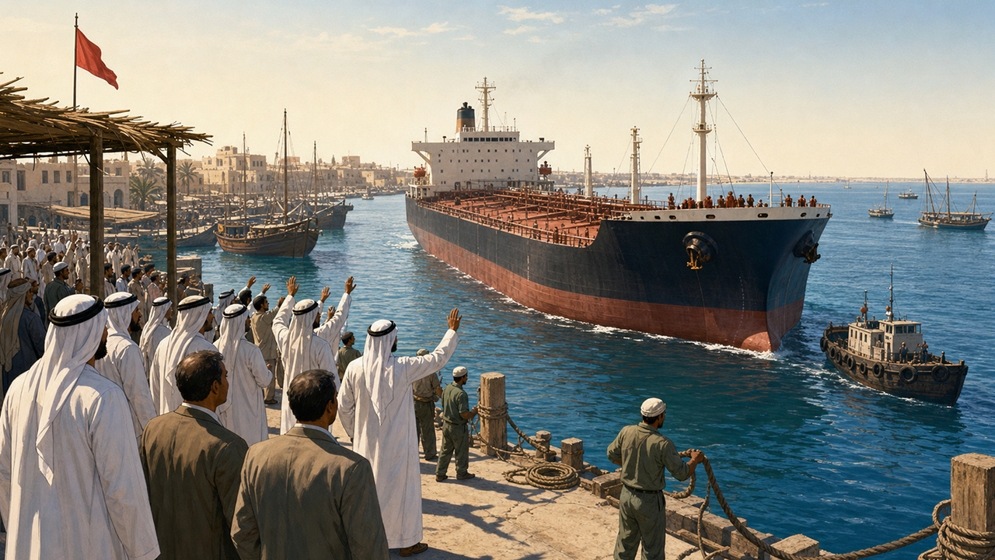
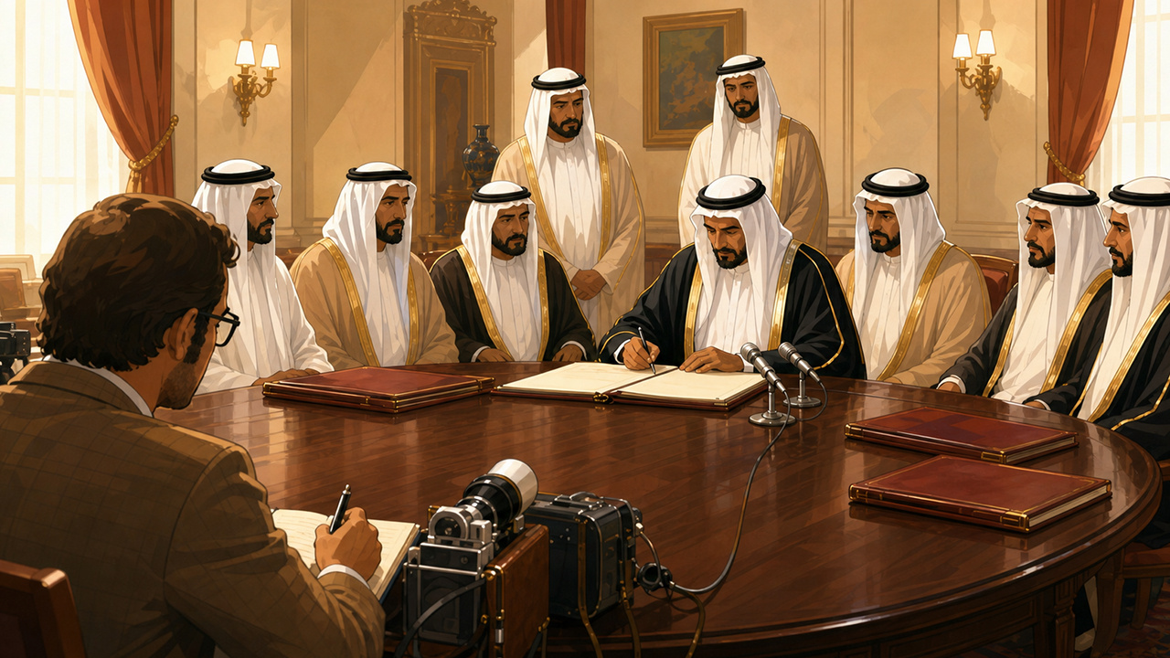
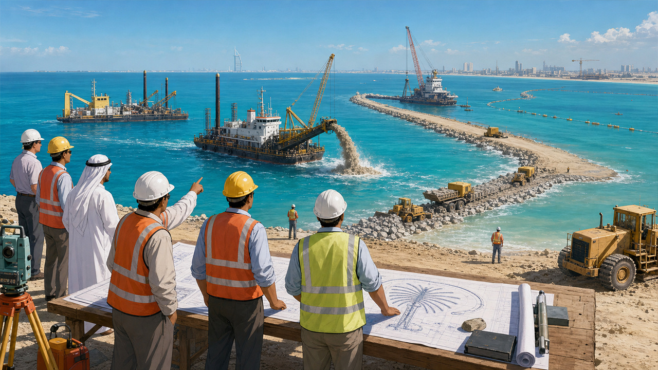
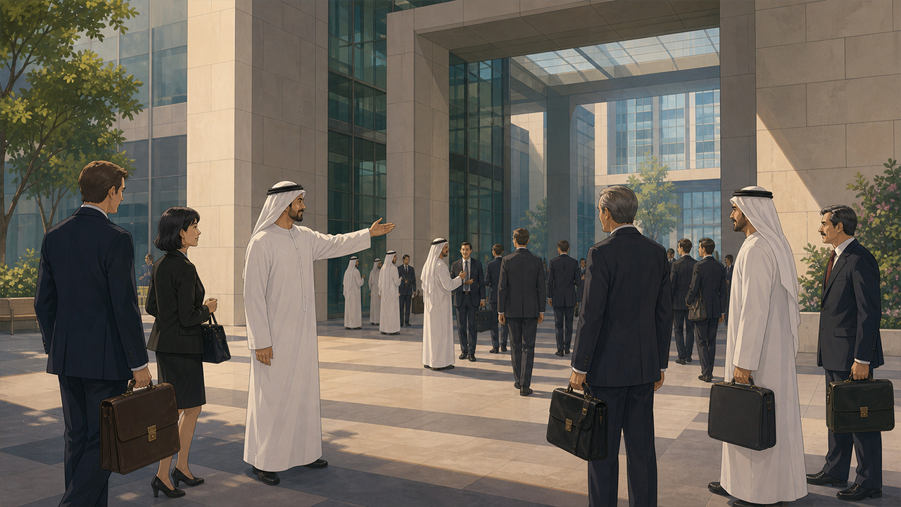
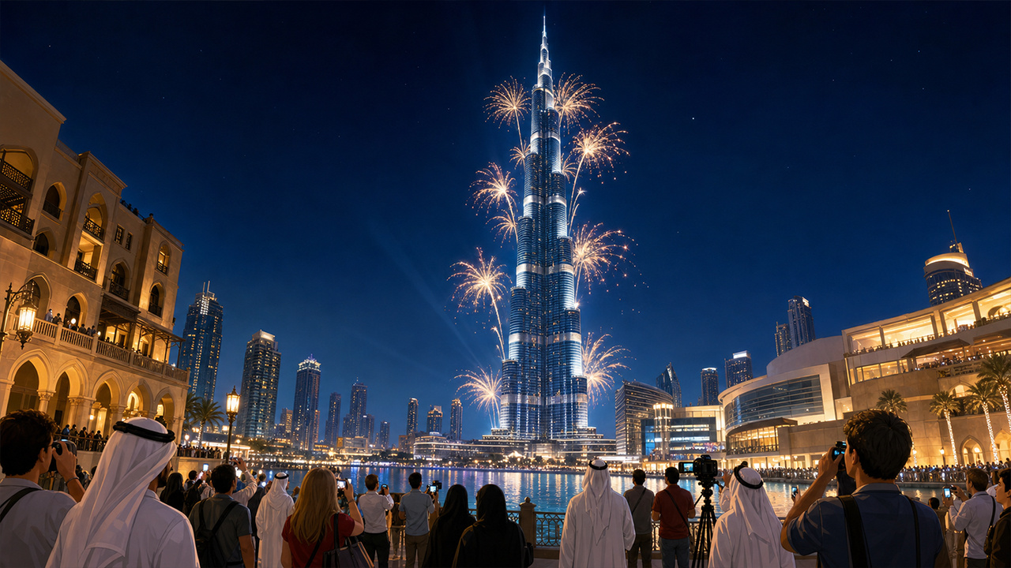
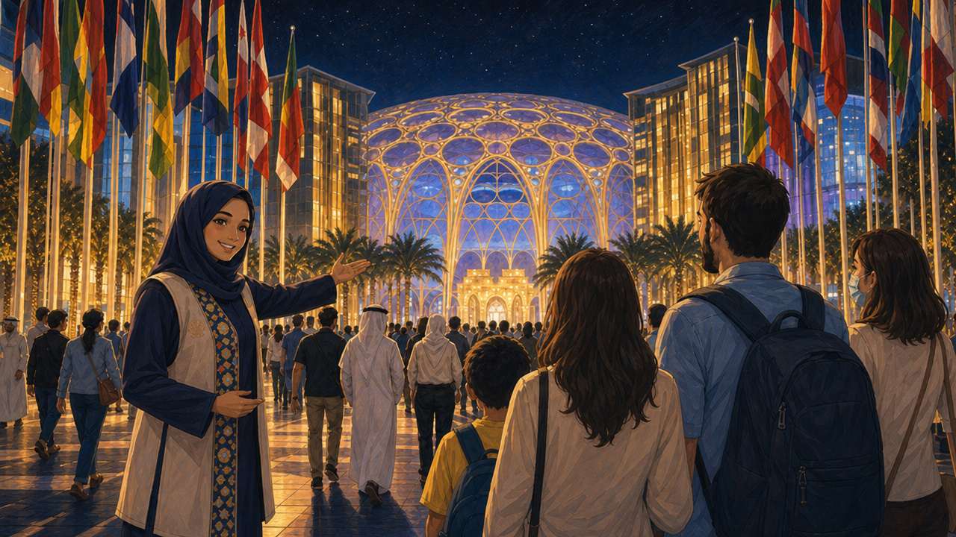
Dubai | Historical Events
10 IMAGES
Notes:
Historical Events is also a demonstration of future vision.

Slide 6

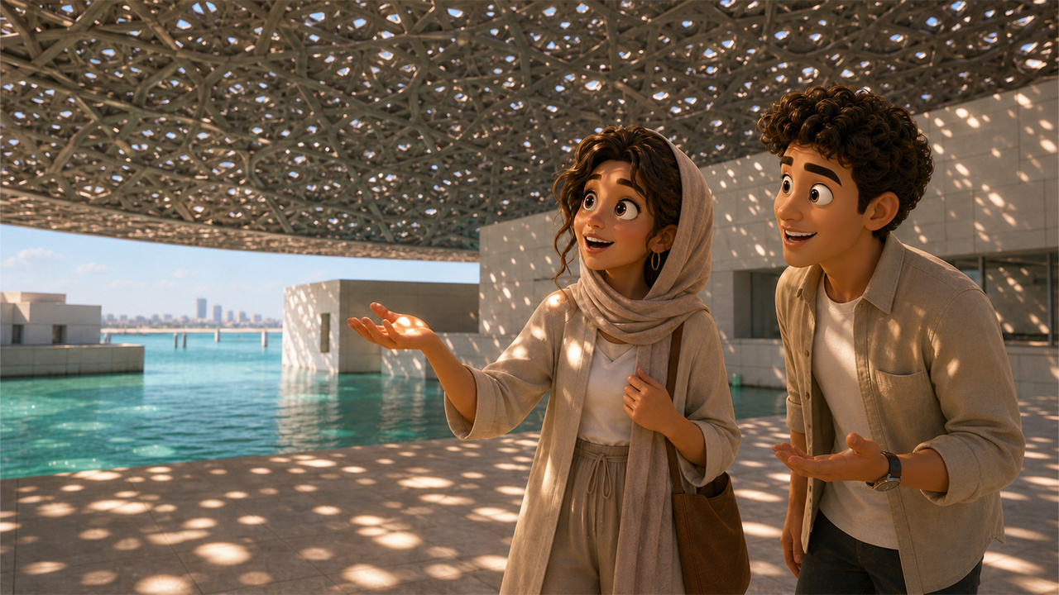
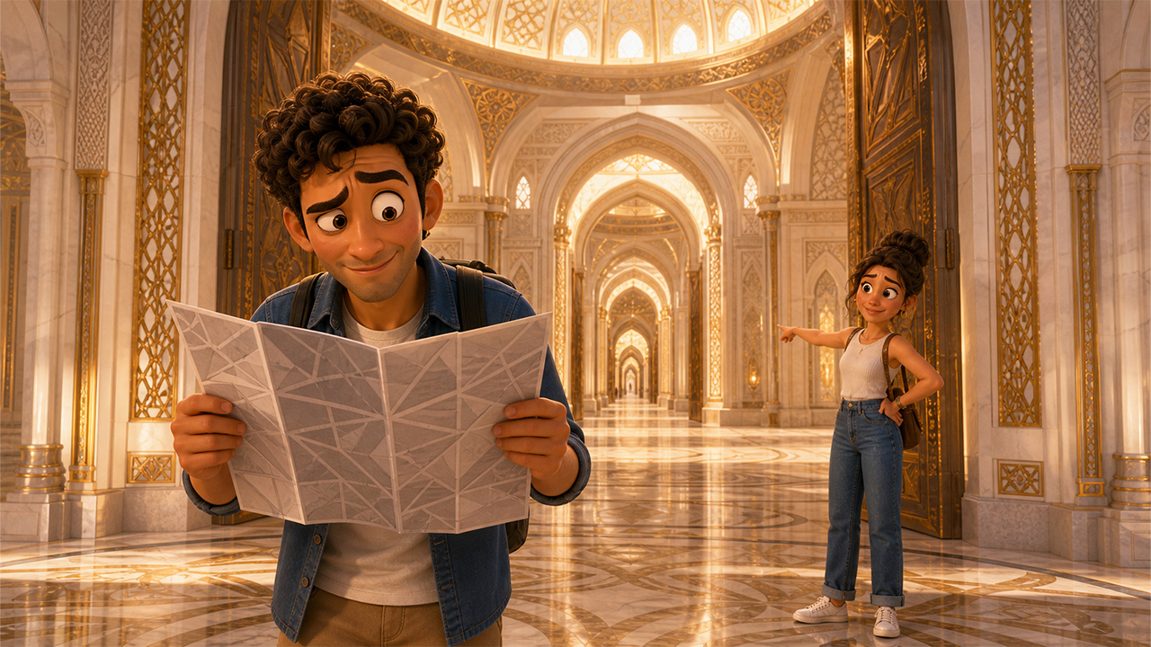









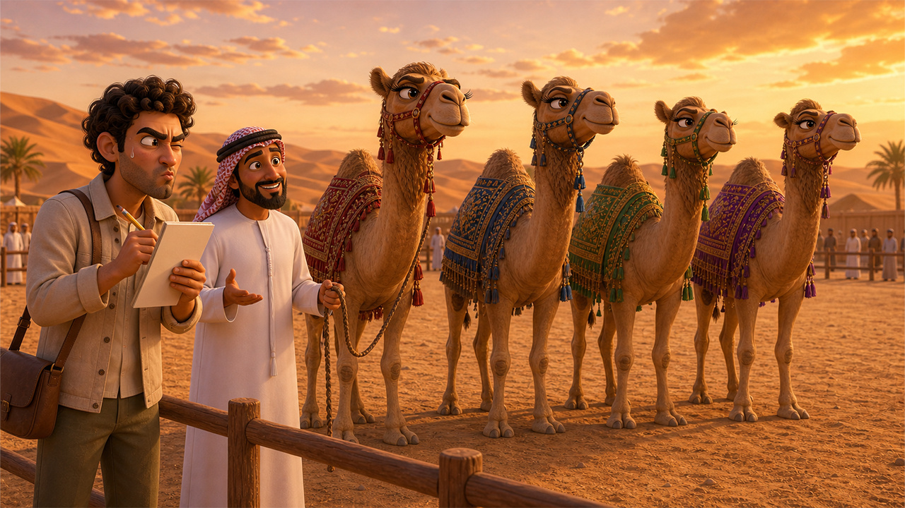
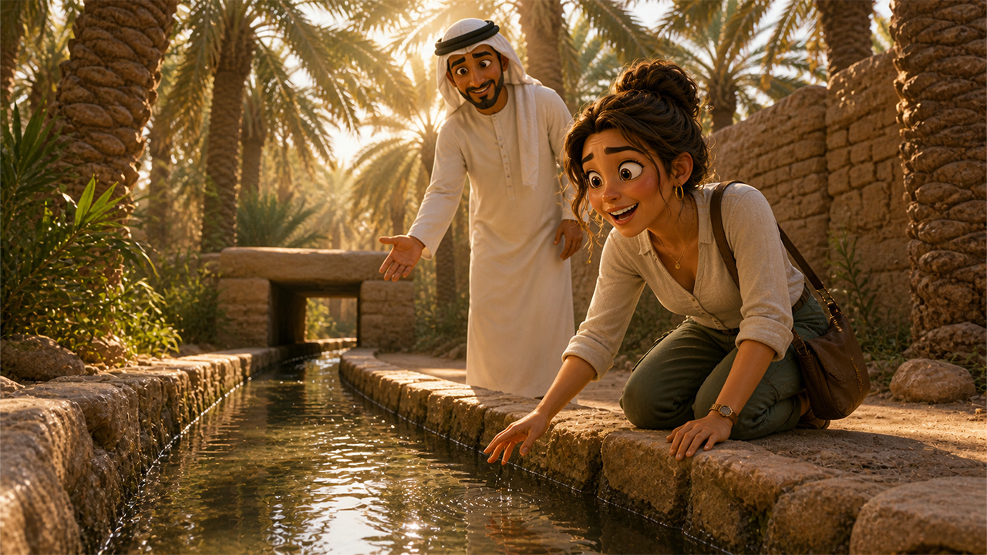



Abu Dhabi | Tourism Events
17 IMAGES
Notes:
When a player lands on an Opportunity space, a tourism random event will be triggered, make the game functionally a global digital showcase for UAE culture, landmarks, lifestyle

Slide 7
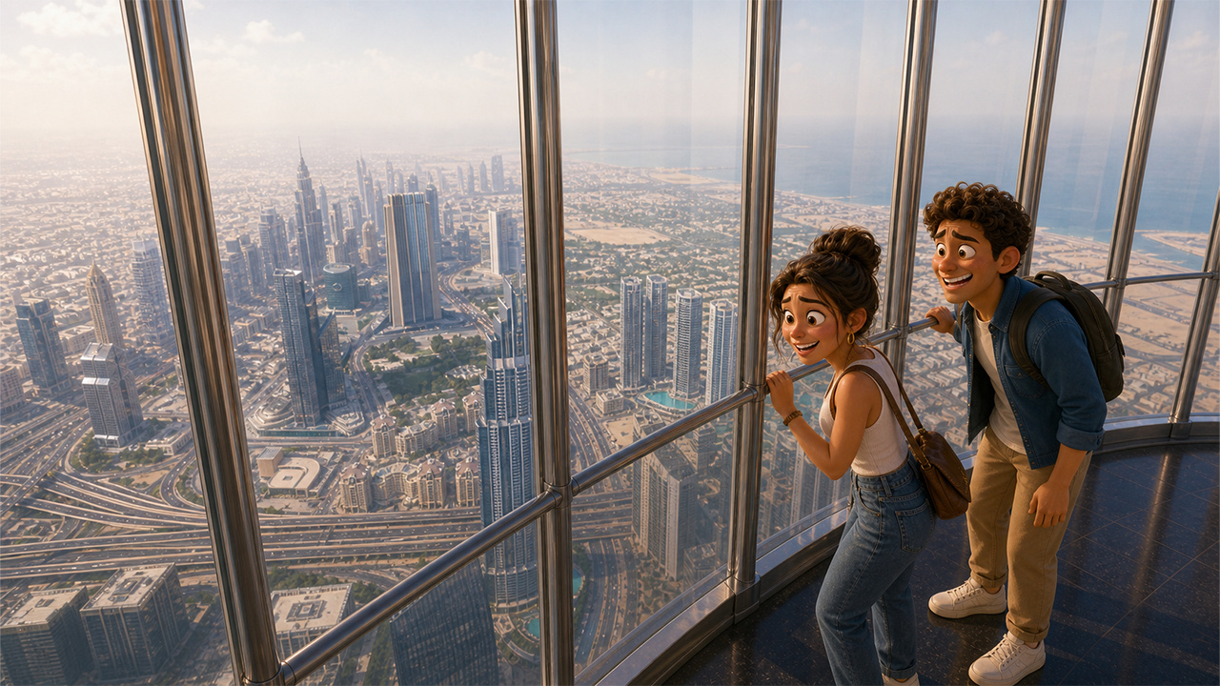

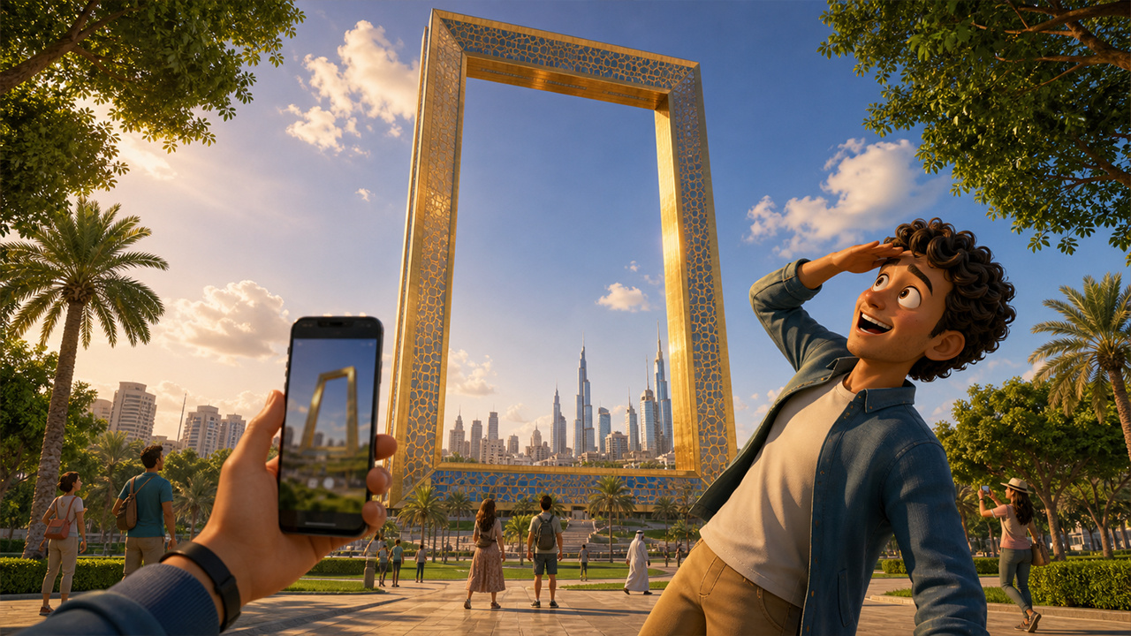
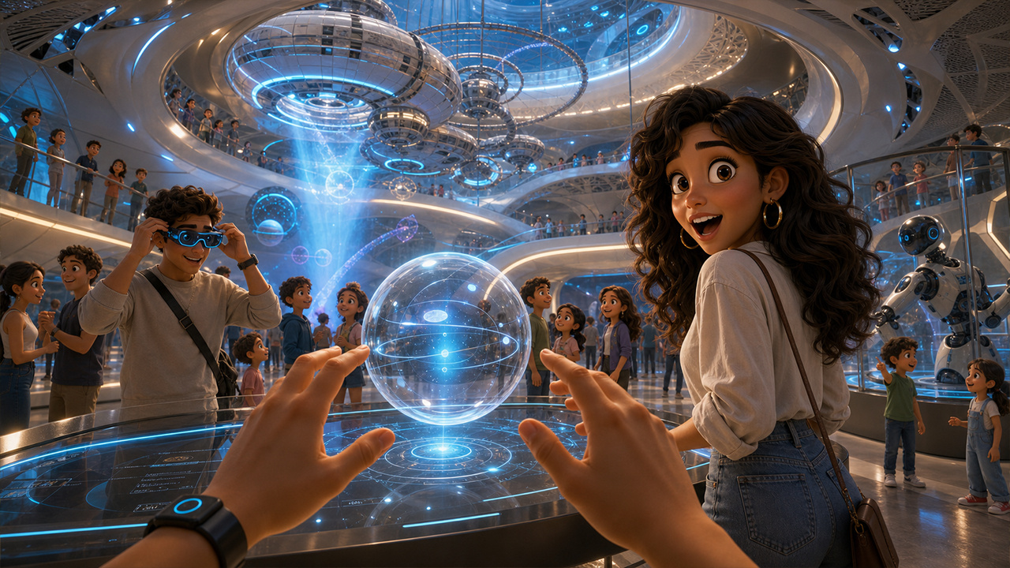
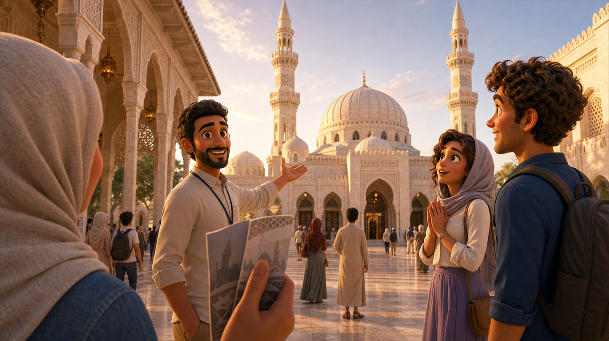




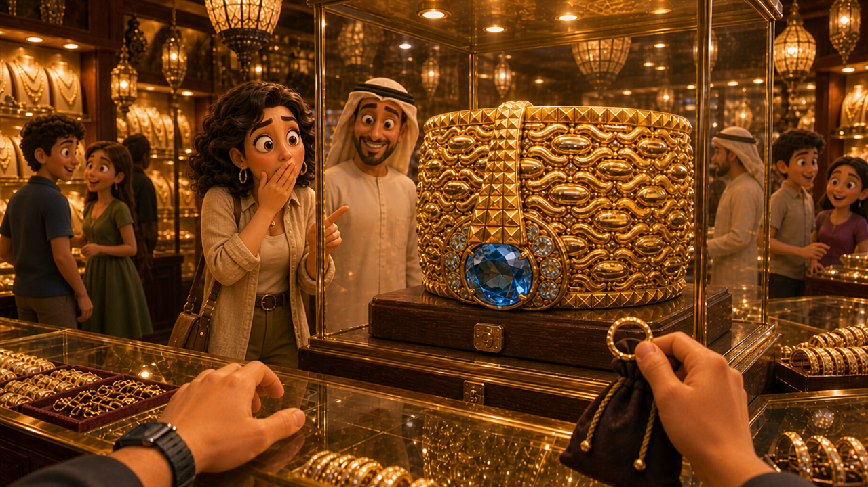
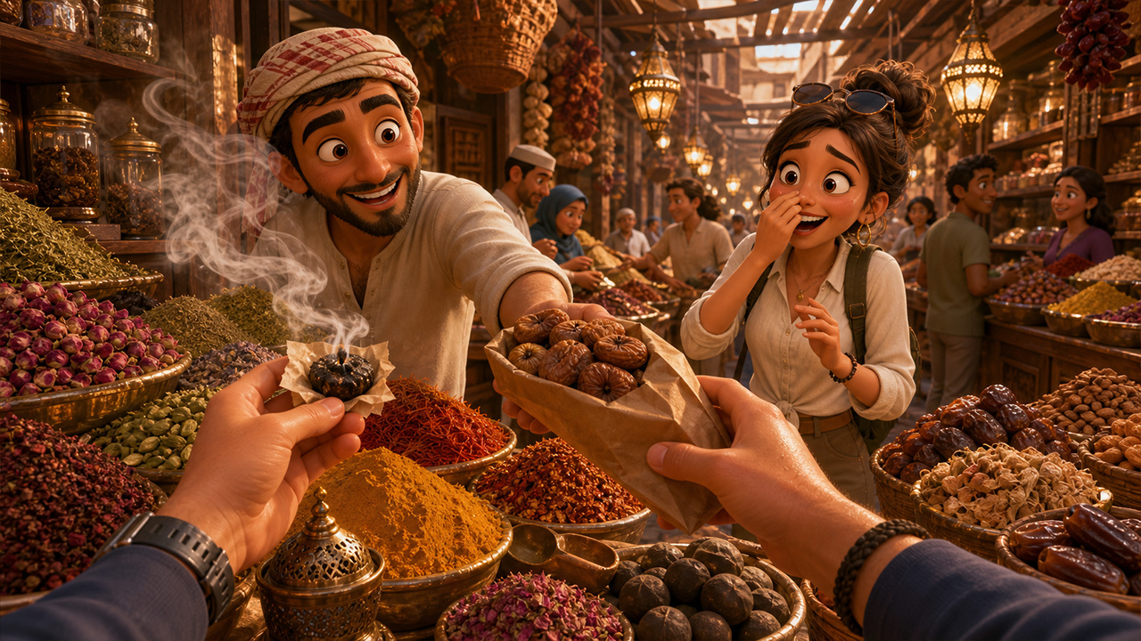





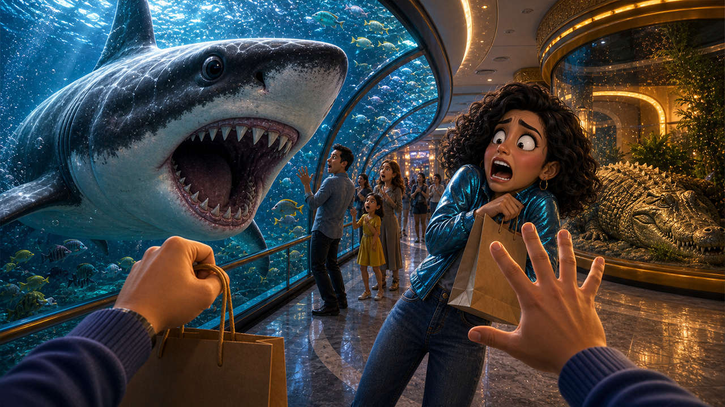

Dubai | Tourism Events
18 IMAGES
Notes:
Inspire people who have never visited the UAE to experience it for themselves.

Slide 8
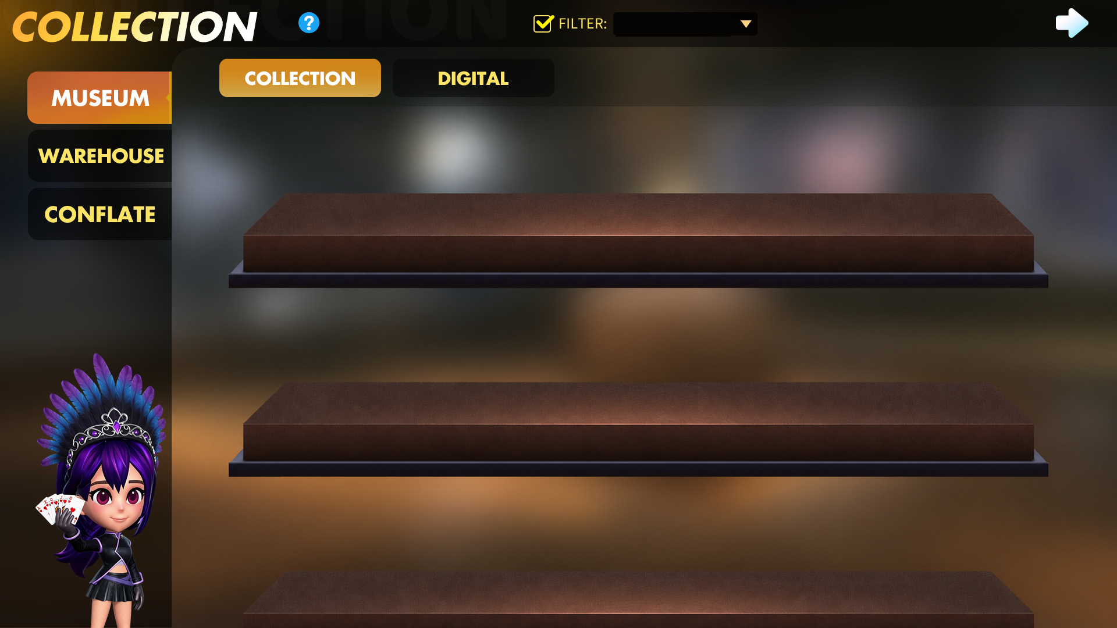
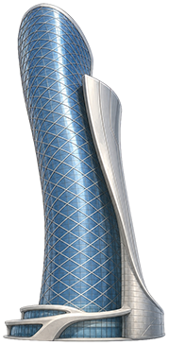

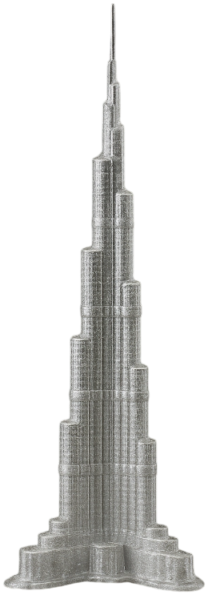
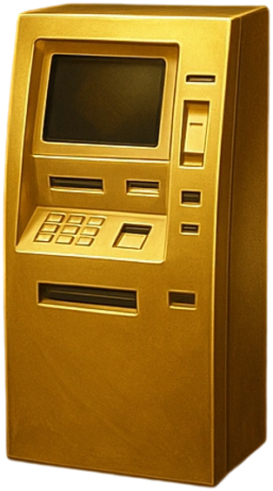

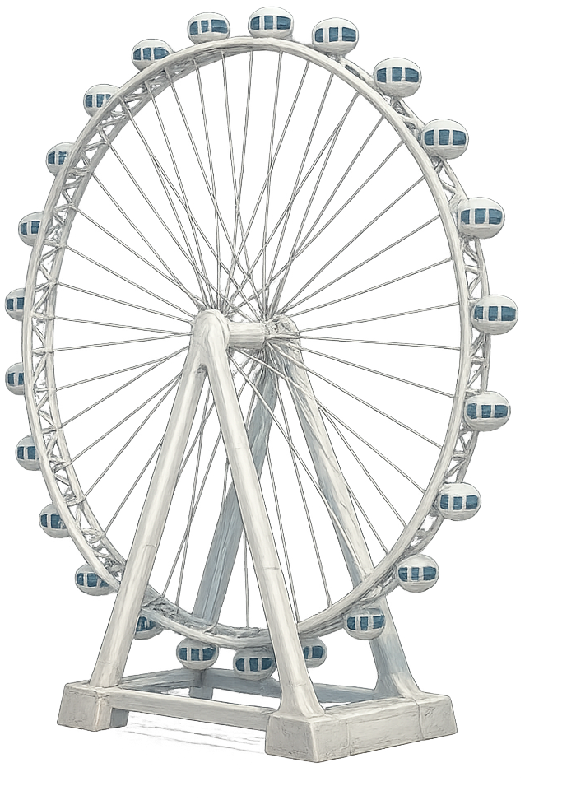







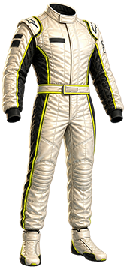








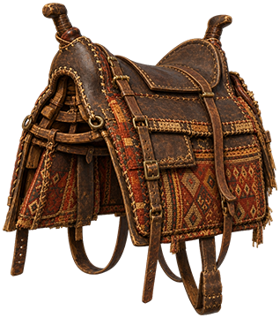



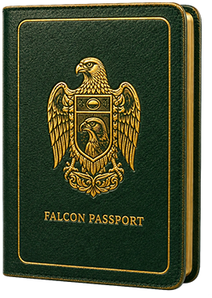


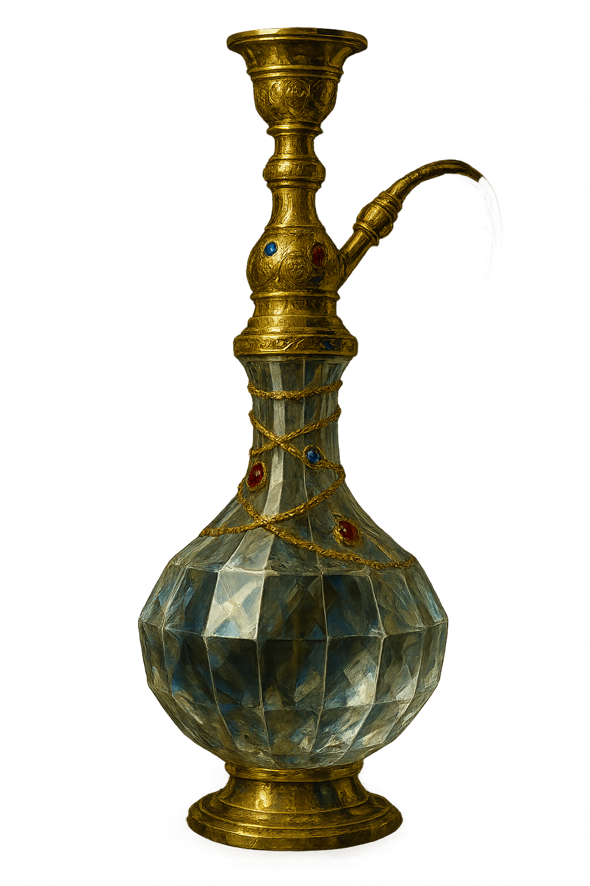

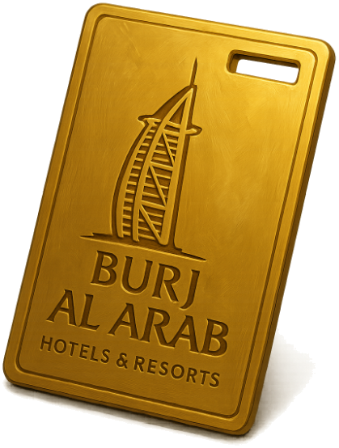
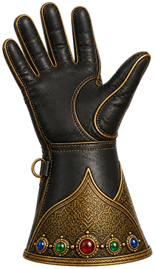



All Cities
Abu Dhabi
Dubai
Abu Dhabi NFT
Notes:
Players can collect cultural artifacts by completing missions.

Slide 9
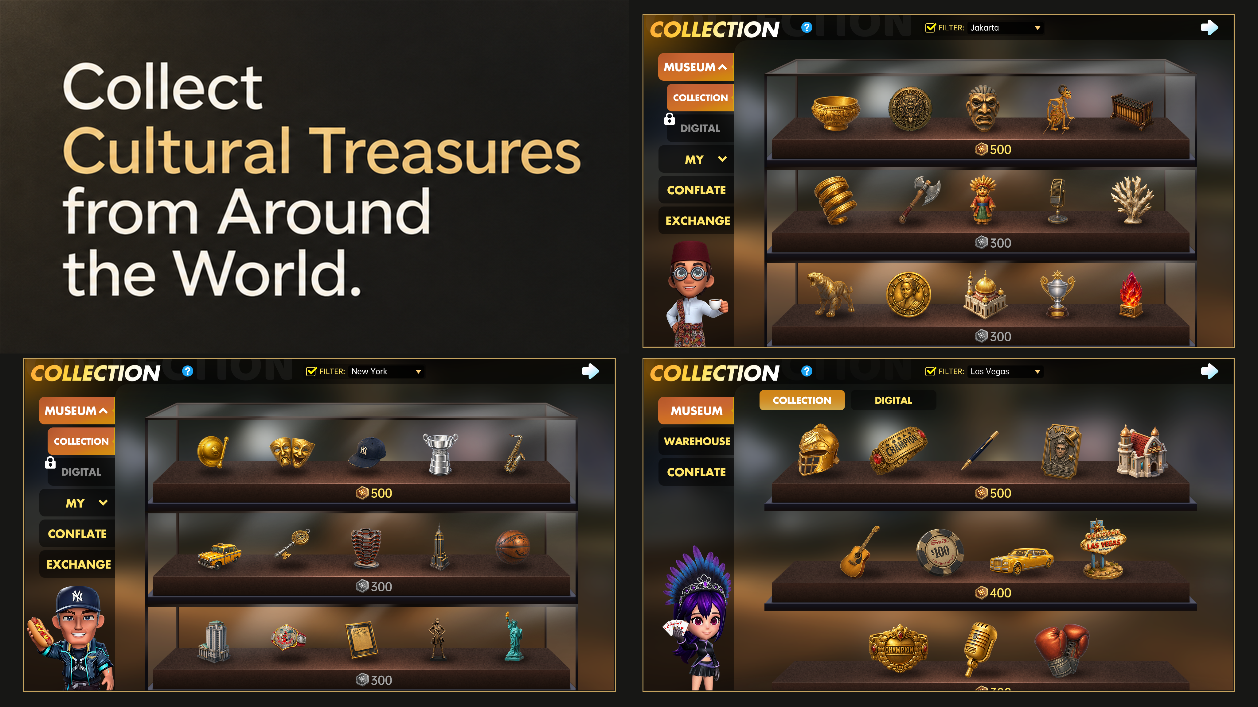
Notes:
Collection competition extends to all cities.

Slide 10
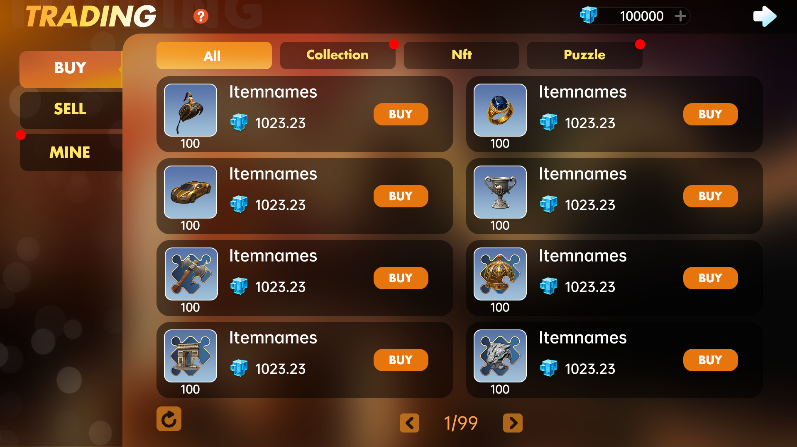
Notes:
Players can trade both collectible fragments and complete collectibles for digital assets, which is the loyalty points to be explained later.

Slide 11
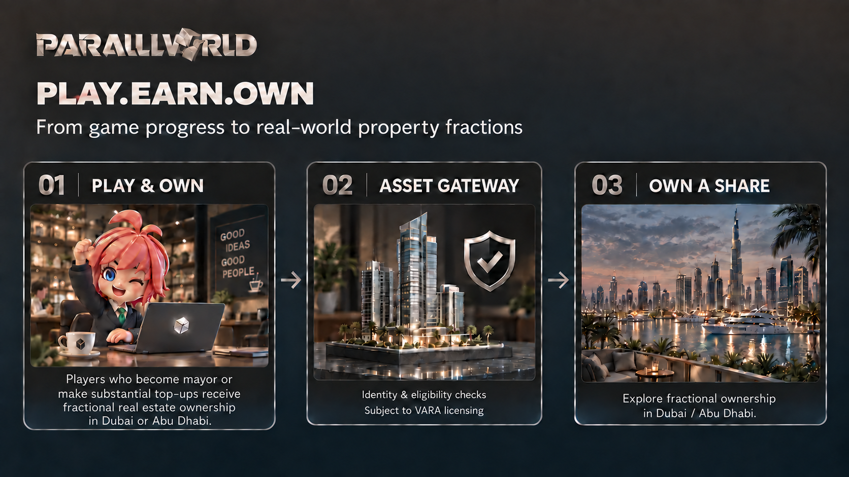
Notes:
Subject to users’ KYC and broker dealer license for property license, players who become mayor or make substantial top-ups contribution receive fractional real estate ownership in Dubai or Abu Dhabi, in the real world.

Slide 12
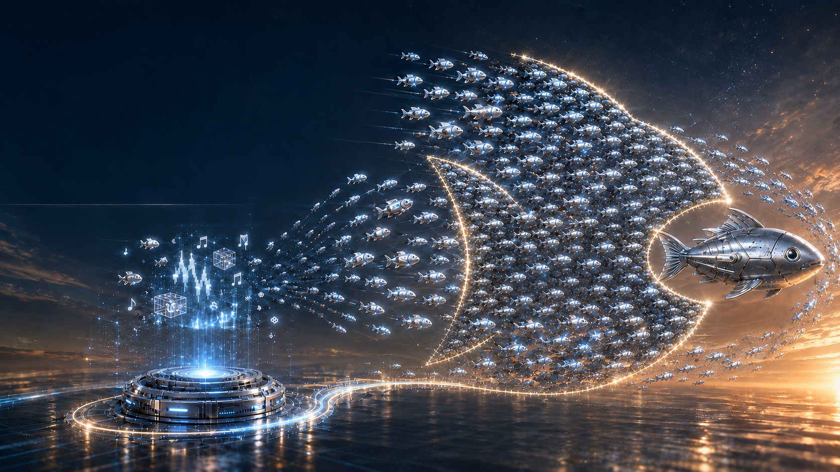
The Next Breakout Market: Gaming
AI Will Disrupt the Gaming Industry
2025 Global Gaming Revenue
US$201.6B
|
+9.1%
≈3× Global Box Office and Recorded Music Revenue Combined
Mini-Game Alliance
Aggregation Effect
Top-Tier Games
AI Lowers Production Barriers
AI Frees Up More Time for Gaming
More Categories | More Titles | Compete Together
Platform Alliances and Traffic Aggregation Build Collective Strength
® 2026, all rights reserved by Future World Holding Ltd
04 / 15
Notes:
Parallel World is not only capable of generating significant traffic and revenue on its own; it also serves as the gateway to a much larger gaming ecosystem. There are already more than 15 million playable digital games worldwide, and the market has already exceeded US$200 billion, that is 3 times of movie and music industry combined. Now, AI can already reduce the time and cost of traditional game development to 10% of their original levels and could bring them down to 1% next year. Before 2030, the number of games worldwide will reach the hundreds of millions. At the same time, AI will give people more time for gaming. Our recommendation is not to bet on individual winners in gaming as Saudi Arabia has done, but instead to build a profit-sharing gaming ecosystem similar to YouTube.

Slide 13
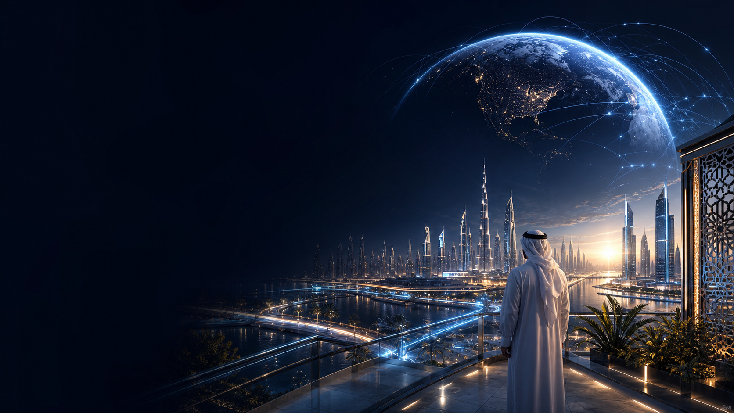
A Simple Business Model
Making the UAE
A Wealth Gateway for Global Players
® 2026, all rights reserved by Future World Holding Ltd
01 / 15
Notes:
Our aim is to use a business model to turn the UAE into a gateway for distributing wealth to players worldwide.

Slide 14
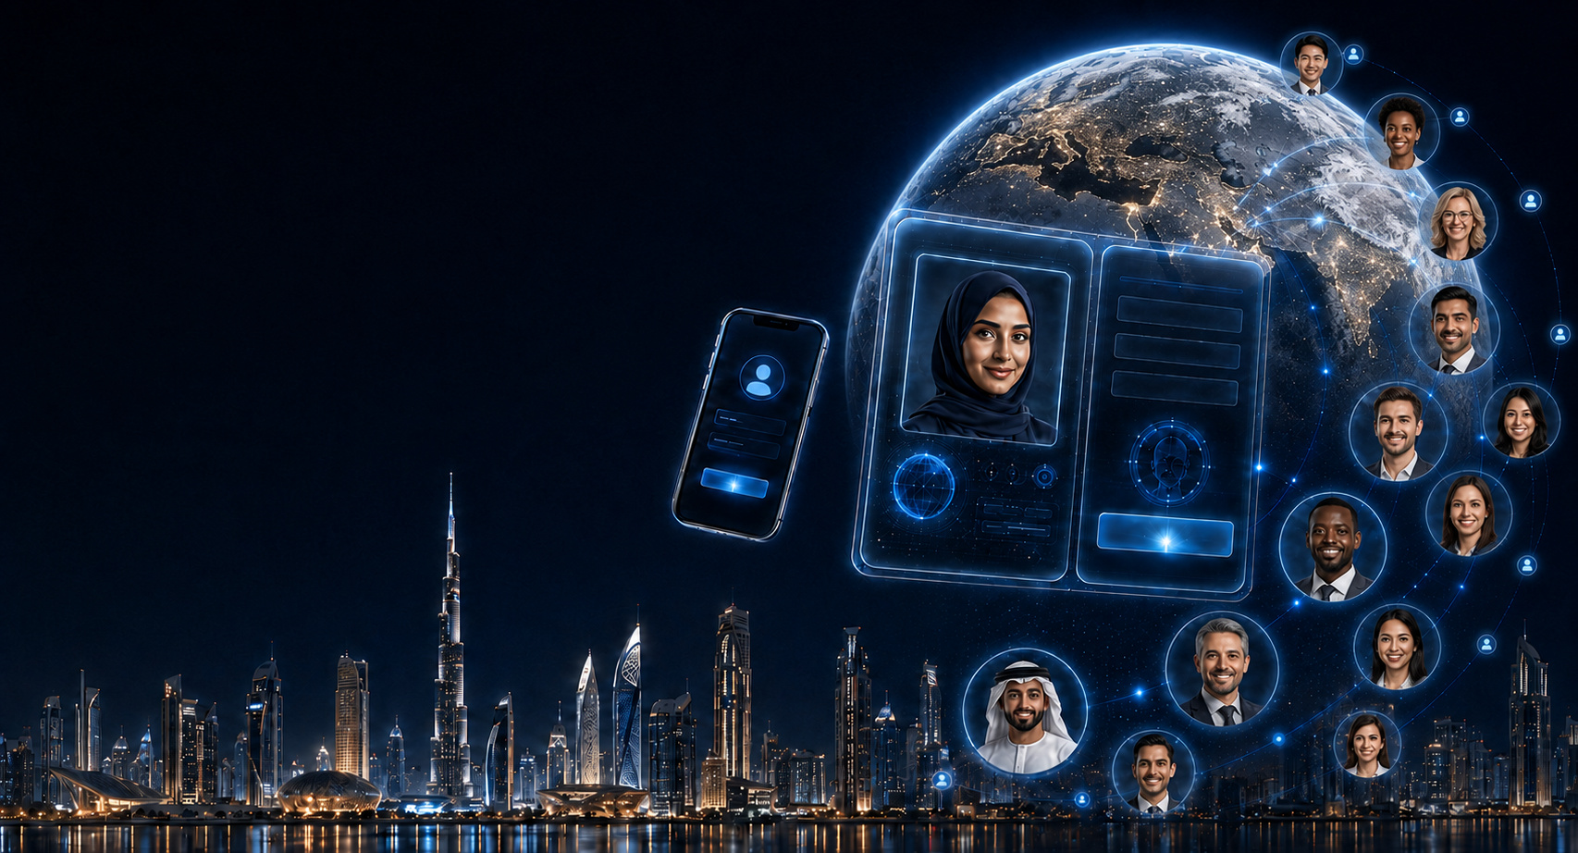
Invite Players Worldwide to
Join the Digital City
as Citizens
Free Registration
® 2026, all rights reserved by Future World Holding Ltd
02 / 15
Notes:
The way how we achieve that is the digital city we are building, named Parallel World. We invite players worldwide to join the City for free.

Slide 15
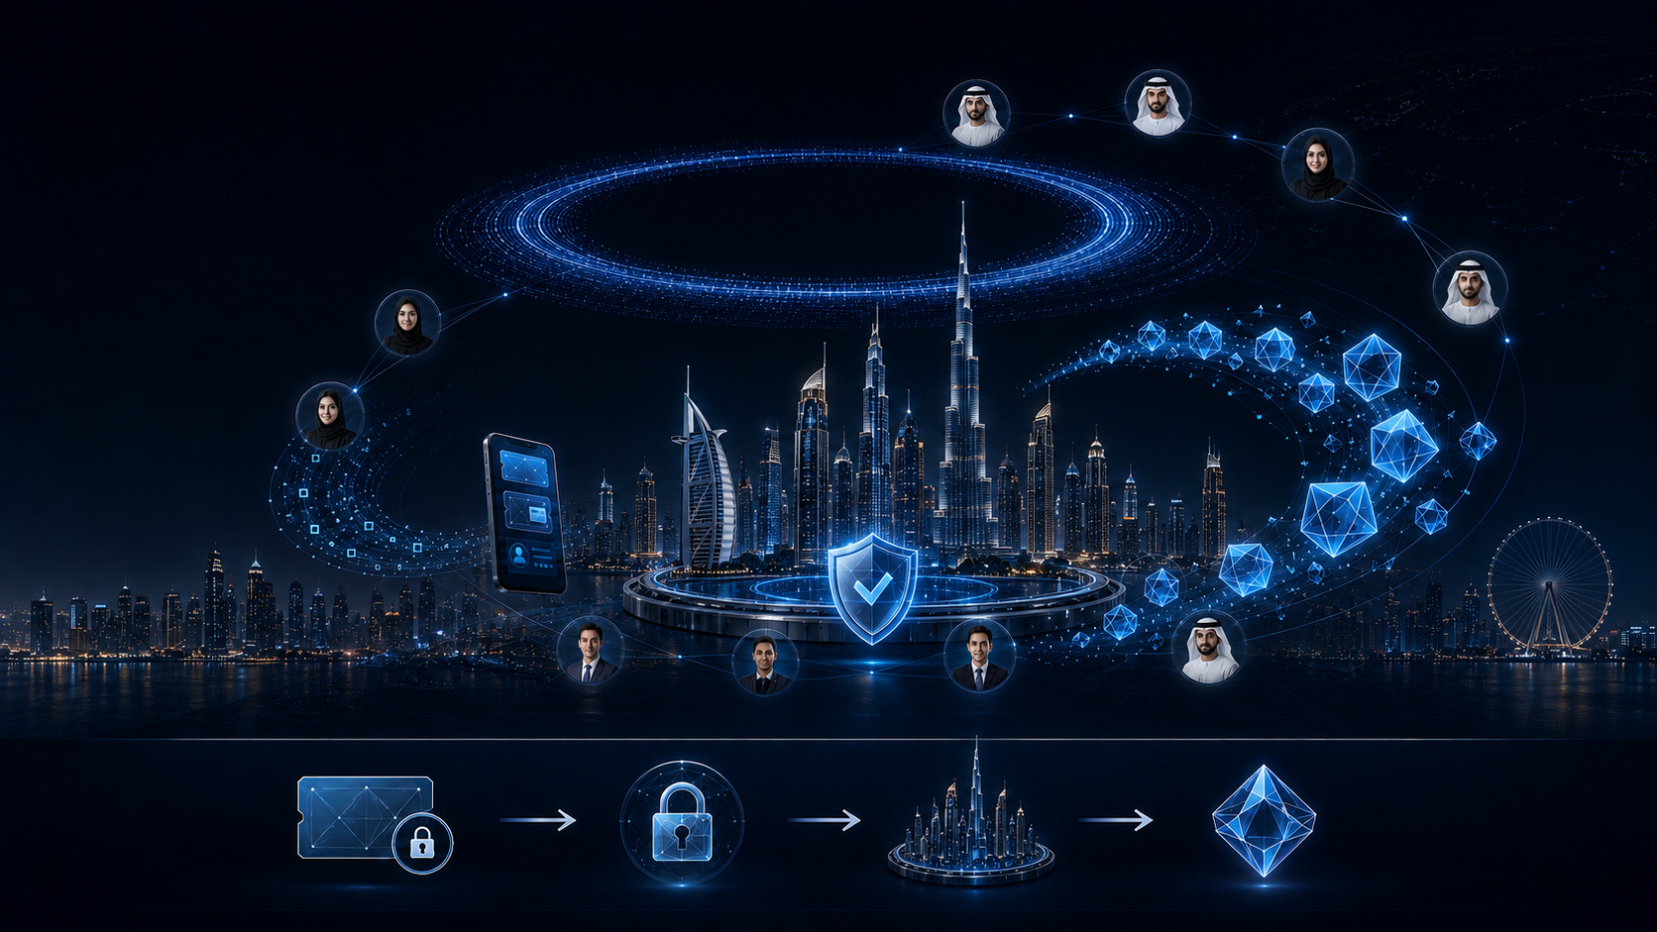
Global Citizens Purchase Vouchers
and Earn Digital Points
Phase 1 Voucher Issuance
US$1 Billion
Matching Digital Points
Initial Participation Target
1 Billion
5 Million Citizens
Fixed Total Supply
Purchase per Citizen
US$200
01
02
03
04
® 2026, all rights reserved
by Future World Holding Ltd
Purchase Vouchers
in US$1 Units
Commit an Equal Amount
to Future Spending
Support City
Development
Earn Matching
Digital Points
03 / 15
Notes:
The Digital City issues vouchers that can only be used for spending and cannot be refunded. In the first phase, they will be sold to 5 million people, with an average purchase US$200, totally 1 billion USD. Citizens' contributions are calculated according to the value of the vouchers they purchase, and they are rewarded accordingly: buying $1 vouchers earns 1 loyalty point reward. The loyalty points are actually blockchain tokens, with the total supply capped at 1 billion. The players can sell the loyalty points at self-defined price after spending vouchers for games.

Slide 16
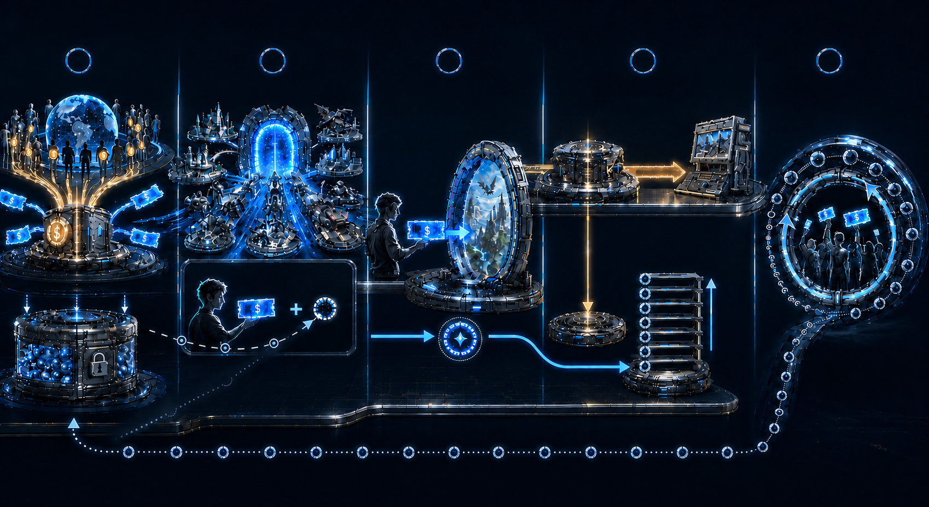
How It Works
1
2
3
4
5
Players Purchase Vouchers with Funds
Attract More Games to Join
Players Share 30% of Revenue
Players Top Up Games
with Vouchers
Spend 1 Voucher
Unlock 1 Point for Sale
Game Operator Settlement
Redistribute Repurchased
Points as Rewards
70%
30%
Point Buybacks
US$1B in Game Vouchers
US$200 Limit per Person
Buy a US$1 Voucher
Buy Back from
Lowest to Highest Price
Get 1 Point
Point Value Increases
Reward Users Buying Vouchers
Beyond the Initial US$1B
Total Loyalty Points: 1B
Complete the Loop
Player & Voucher Flow
Funds & Settlement Flow
Loyalty-Point Flow
® 2026, all rights reserved by Future World Holding Ltd
05 / 15
Notes:
So the whole process is like this: as citizens purchase vouchers, the Digital City, accumulates more and more locked-in spending, making it increasingly attractive to game companies and gaming platforms. So long as a legal game that accepts vouchers and offers a revenue-sharing rate can join our platform. For example, suppose a game's revenue-sharing rate is 30%: when a player spends 100 dollars, 70 dollars is paid to the game merchant in settlement, and 30 dollars goes into Parallel World's Treasury to buy back loyalty points listed for sale by players. Revenue-sharing rates in the gaming industry range from 10% to 90%. Assuming an average of 30%, the funds accumulated in Parallel World's treasury for buying back points in the first phase could reach US$300 million.

Slide 17


Point Sales and Value Growth
Recirculate Points
Point Listings
Receive Sale Proceeds
Player
Points
USD
Player F
7,500
$220
New Players
Player E
6,000
$200
Existing
Player
10,000
$180
Sell Points
Player C
3,500
$150
Player B
8,000
$120
Player A
5,000
$100
Cash Flow Buybacks
Lift Prices From Low to High
Buy Back Points
Lowest Price First
Points Vault
® 2026, all rights reserved by Future World Holding Ltd
06 / 15
Notes:
As player spending and shared gaming revenue keeps going into the Treasury, the digital city uses smart contracts to buy back loyalty points continuously. Because the total supply is capped, the price of loyalty points will continue to appreciate from low to high. The repurchased points are recirculated as gifts to players who newly purchase vouchers, and the buyback funds are distributed to players who sell their loyalty points.

Slide 18

Business Model Scalability
Game Operators
Games
Parallel World
Business Ecosystem
UAE Business Profits
Global Business Profits
Points Buyback Fund
Real Estate Developers
Merchants
Properties
Goods
Merchants Set Their
Revenue Share
Services
® 2026, all rights reserved by Future World Holding Ltd
07 / 15
Notes:
This economic model can be extended at any time to sectors such as traditional commerce and real estate, achieving coverage across all industries and all regions.

Slide 19

Merchant Participation
US$1 Billion
Merchant Onboarding
Voucher = Locked Future Spending
Merchants Accepting
Voucher Payments
Contribution Rate
Set by Each Merchant
Free Entry to the
Digital City
N%
® 2026, all rights reserved by Future World Holding Ltd
08 / 15
Notes:
Merchants can connect to the digital city as long as they are willing to accept vouchers for settlement and set a revenue-sharing rate.

Slide 20

Voucher Use
& Settlement
Merchant
Voucher Settlement
Pay with Vouchers
Net Settlement
100% − N%
Retain N%
Points Vault
Player
Resell Collected Vouchers
AI Digital City
® 2026, all rights reserved by Future World Holding Ltd
09 / 15
Notes:
Players transfer vouchers to merchants, who then transfer them to digital city for settlement. The digital city likewise puts the revenue-sharing portion into the Treasury and settles the remainder with the merchants. For better-known and larger merchants (such as Emirates airline), we can place a security deposit with the merchant in advance. The merchant deducts amounts from this deposit based on the number of vouchers transferred to our digital city, enabling rapid cooperation with zero trust required. Vouchers are recirculated within the system and are not subject to the total limit of 1 billion.

Slide 21

Sustainable Circular Economy Model
01
02
03
04
05
Online Purchase
Merchant Participation
Voucher Payment
Settlement & Storage
Buyback & Value Growth
® 2026, all rights reserved by Future World Holding Ltd
10 / 15
Notes:
For offline merchants, after shopping and before checkout, consumers scan the merchant's QR code and transfer vouchers. This does not affect the shopping experience; it only changes the payment method. This will expand the sources of loyalty point appreciation from a share of gaming revenue to merchant revenue. Whether tickets to scenic attractions or events, or even real estate, all can join the Parallel World ecosystem as long as the merchant is willing to contribute a certain proportion of sales revenue.

Slide 22

The Flywheel Effect
01
More Vouchers
07
More Players
02
More Merchants
Value Circulation and Growth
Co-Creation
Shared Prosperity
Shared Ownership
06
Higher Point
Value
03
Digital City
Higher Spending
Loyalty
Points
A New Commercial Ecosystem
Everyone’s participation
fuels the next cycle of growth.
05
04
More Buyback Funding
Higher Merchant Returns
® 2026, all rights reserved by Future World Holding Ltd
11 / 15
Notes:
The entire process will create a flywheel effect: the more vouchers are sold, the more merchants are attracted, the more vouchers are used, the greater the revenue share from merchants, the more funds are available to buy back loyalty points, the more appreciation, and the more players are attracted. Everyone’s participation fuels the next cycle of growth. This will create a new commercial civilization in Abu Dhabi and UAE based on joint creation, sharing ownership and prosperity.

Slide 23

Nature of Points
Spend at Partner Merchants
Merchant Contributions
to the Points Treasury
Purchase Vouchers
Players Cannot
Purchase Points Directly
Digital City Uses Treasury Funds
for Ongoing Buybacks
Point Value Appreciation
01 Legal Classification
02 Player Acquisition
03 Platform Transactions
UAE Review Required
Awarded Free of Charge
No Risk of Loss for Players
No fundraising or fixed returns promised.
Securities status requires UAE legal review.
Players receive points at no charge.
Players do not contribute capital.
The platform buys back points only.
It does not sell points to players.
® 2026, all rights reserved by Future World Holding Ltd
13 / 15
Notes:
The nature of loyalty points are not financial investment products. The only way for players to obtain loyalty points is to receive them as gifts when buying vouchers; they cannot purchase points directly or invest in them. The platform can only buy back loyalty points, not sell them.

Slide 24

Global Expansion
Connecting people in the UAE
to a global digital commerce network
01
Purchases Only
02
Local Currency Settlement
03
Local Tax Compliance
No cash redemption or transfers.
Vouchers are for purchases only.
Merchants settle vouchers in local currency.
The model retains national currency systems.
Merchants pay applicable local taxes.
The model follows each country’s tax rules.
® 2026, all rights reserved by Future World Holding Ltd
12 / 15
Notes:
When the model extends beyond the UAE, compliance issues arise. Our confidence in compliance comes from three aspects:
Loyalty points are not investment products
Following settlement with overseas merchants, payment is made in the local legal currency, without affecting the local monetary system
After settlement, overseas merchants pay taxes locally in accordance with the rules, without affecting the local tax system

Slide 25

Why Now
Waiting Years Could Be Too Late
Potential Downside Scenario
A Safety Net to Protect
Players’ Purchasing Power
01
Job Displacement
Reduced working hours could lower
income and purchasing power.
of jobs could be
replaced by AI within
02
Weaker Player Demand
95%
Lower sales could lead to business
closures and further job losses.
3–6 Years
03
Pressure on Public Finances
Source-deck claim. Verification pending.
Not a validated UAE forecast.
Lower revenue and greater support
needs could strain public budgets.
Source Deck Attribution (Unverified)
04
Purchasing Power at Risk
Ben Goertzel, AI Researcher
Sam Altman, OpenAI Co-Founder
Inflation could deepen income losses
and increase social tensions.
Illustrative risks. UAE outcomes depend on adoption, productivity and policy responses.
® 2026, all rights reserved by Future World Holding Ltd
14 / 15
Notes:
Why now? This business model enables the public to obtain appreciating digital assets without investment, protecting the purchasing power of players worldwide. If we wait another 2-3 years, it will be too late, because a vicious cycle is now spinning ever faster: AI replaces people's working time and purchasing power, declining merchant revenue leads to further layoffs and reduces government tax revenue, and governments accelerate money printing, causing currency depreciation and further squeezing people's purchasing power. We need to bring this new economic engine out while users still have money to spend, so that a snowball effect takes shape before getting too late.

Slide 26

We Create It.
We Do Not Wait for the Future.
Why the UAE
01
The UAE offers streamlined and efficient decision-making on disruptive innovations, especially compared to Western countries.
04
The UAE hosts major international exhibitions every year, bringing together merchants from around the world and enabling the rapid formation of a large-scale merchant alliance.
02
DXB’s 92.3 million passengers (2024) and Dubai’s 17.15 million international visitors (2023) fuel the flywheel’s global expansion.
05
Over the past 20 years, the UAE’s world-first achievements and business-friendly policies have built global influence and positioned it the best to lead a new culture of global commerce.
03
The UAE is already a global financial centre. By leveraging this model, it can maintain an unchallenged leadership position in the future.
06
The UAE has strong demand to transform its growth model, diversify beyond energy, and strengthen economic stability under geopolitical uncertainty.
Traffic: Dubai Airports (2024); Dubai DET (2023).
15 / 15
® 2026, all rights reserved by Future World Holding Ltd

Slide 27
UAE DIGITAL CITY – PARALLEL WORLD
The World Plays.
The UAE Leads.
Building lasting emotional and financial ties between global players and the UAE.
Let’s launch from Abu Dhabi, together.
Next step: business-model approval and a licensing pathway for fractional property ownership.

